Slide 1

Natural Language Processing N-Grams
1

Slide 2

The problem
Using the notion of word prediction for processing language
Example:
What word is most likely to follow: I’d like to make a collect call
Using probabilistic models called N-grams to predict the next word from the previous n-1 words.
Computing the probability of the next word is related to computing the probability of a sequence of words.
Has a non-zero probability of appearing in a text
The same words in a different order have a very low probability
Copyright 2003 by Dan Moldovan
2

Slide 3
Today
Word prediction task
Language modeling (N-grams)
N-gram intro
The chain rule
Model evaluation
Smoothing
3

Slide 4
Word Prediction
Guess the next word...
... I notice three guys standing on the ???
There are many sources of knowledge that can be used to inform this task, including arbitrary world knowledge.
But it turns out that you can do pretty well by simply looking at the preceding words and keeping track of some fairly simple counts.
4

Slide 5
Word Prediction
We can formalize this task using what are called N-gram models.
N-grams are token sequences of length N.
Our earlier example contains the following 2-grams
(I notice), (notice three), (three guys), (guys standing), (standing on), (on the)
Given knowledge of counts of N-grams such as these, we can guess likely next words in a sequence.
5

Slide 6
N-Gram Models
More formally, we can use knowledge of the counts of N- grams to assess the conditional probability of candidate words as the next word in a sequence.
Or, we can use them to assess the probability of an entire sequence of words.
Pretty much the same thing as we’ll see...
6

Slide 7
Applications
It turns out that being able to predict the next word (or any linguistic unit) in a sequence is an extremely useful thing to be able to do.
It lies at the core of the following applications
Automatic speech recognition
Handwriting and character recognition
Spelling correction
Machine translation
And many more.
7

Slide 8
Counting
Simple counting lies at the core of any probabilistic approach. So let’s first take a look at what we’re counting.
He stepped out into the hall, was delighted to encounter a water brother.
13 tokens, 15 if we include “,” and “.” as separate tokens.
Assuming we include the comma and period, how many bigrams are there?
8

Slide 9
Counting
Not always that simple
I do uh main- mainly business data processing
Spoken language poses various challenges.
Should we count “uh” and other fillers as tokens?
What about the repetition of “mainly”? Should such do- overs count twice or just once?
The answers depend on the application.
If we’re focusing on something like ASR to support indexing for search, then “uh” isn’t helpful (it’s not likely to occur as a query).
But filled pauses are very useful in dialog management, so we might want them there.
9

Slide 10
Counting: Types and Tokens
How about
They picnicked by the pool, then lay back on the grass and looked at the stars.
18 tokens (again counting punctuation)
But we might also note that “the” is used 3 times, so there are only 16 unique types (as opposed to tokens).
In going forward, we’ll have occasion to focus on counting both types and tokens of both words and N-grams.

Slide 11
Counting: Wordforms
Should “cats” and “cat” count as the same when we’re counting?
How about “geese” and “goose”?
Some terminology:
Lemma: a set of lexical forms having the same stem, major part of speech, and rough word sense
Wordform: fully inflected surface form
Again, we’ll have occasion to count both lemmas and wordforms

Slide 12
Counting: Corpora
So what happens when we look at large bodies of text instead of single utterances?
Brown et al (1992) large corpus of English text
583 million wordform tokens
293,181 wordform types
Google
Crawl of 1,024,908,267,229 English tokens
13,588,391 wordform types
That seems like a lot of types... After all, even large dictionaries of English have only around 500k types. Why so many here?
Numbers
Misspellings
Names
Acronyms
etc

Slide 13
Language Modeling
Back to word prediction
We can model the word prediction task as the ability to assess the conditional probability of a word given the previous words in the sequence
P(w_{n}|w₁,w₂…w_{n-1})
We’ll call a statistical model that can assess this a Language Model

Slide 14
Language Modeling
How might we go about calculating such a conditional probability?
One way is to use the definition of conditional probabilities and look for counts. So to get
P(the | its water is so transparent that)
By definition that’s
P(its water is so transparent that the) P(its water is so transparent that)
We can get each of those from counts in a large corpus.

Slide 15
Very Easy Estimate
How to estimate?
P(the | its water is so transparent that)
P(the | its water is so transparent that) = Count(its water is so transparent that the)
Count(its water is so transparent that)

Slide 16
Very Easy Estimate
According to Google those counts are 5/9.
Unfortunately... 2 of those were to these slides... So maybe it’s really
3/7
In any case, that’s not terribly convincing due to the small numbers involved.

Slide 17
Language Modeling
Unfortunately, for most sequences and for most text collections we won’t get good estimates from this method.
What we’re likely to get is 0. Or worse 0/0.
Clearly, we’ll have to be a little more clever.
Let’s use the chain rule of probability
And a particularly useful independence assumption.

Slide 18
The Chain Rule
Recall the definition of conditional probabilities
P( A | B) = ^{P( A^ B)}
Rewriting:
P(B)
P( A^ B) = P( A | B)P(B)
For sequences...
P(A,B,C,D) = P(A)P(B|A)P(C|A,B)P(D|A,B,C)
In general
P(x₁,x₂,x₃,…x_{n}) = P(x₁)P(x₂|x₁)P(x₃|x₁,x₂)…P(x_{n}|x₁…x_{n-1})

Slide 19
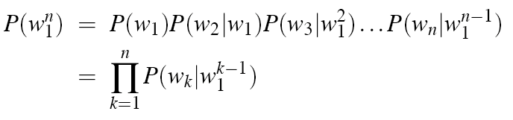
The Chain Rule
P(its water was so transparent)=
P(its)*
P(water|its)* P(was|its water)*
P(so|its water was)* P(transparent|its water was so)

Slide 20
Unfortunately
There are still a lot of possible sentences
In general, we’ll never be able to get enough data to compute the statistics for those longer prefixes
Same problem we had for the strings themselves

Slide 21
Independence Assumption
Make the simplifying assumption
P(lizard|the,other,day,I,was,walking,along,and,saw,a)
= P(lizard|a)
Or maybe
P(lizard|the,other,day,I,was,walking,along,and,saw,a)
= P(lizard|saw,a)
That is, the probability in question is independent of its earlier history.

Slide 22
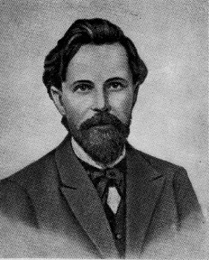

Independence Assumption
This particular kind of independence assumption is called a Markov assumption after the Russian mathematician Andrei Markov.

Slide 23
Markov Assumption
So for each component in the product replace with the approximation (assuming a prefix of N)
P(wn | w^{n−1}) ≈ P(wn | w^{n−1} )
1 n− N +1
Bigram version
P(w | w^{n−1}) ≈ P(w
n 1
| w )
n
n−1

Slide 24
Estimating Bigram Probabilities
The Maximum Likelihood Estimate (MLE)
₎ ₌ count(w_{i−1},w_{i} )
P(w | w
i
i−1
count(w )
i−1

Slide 25
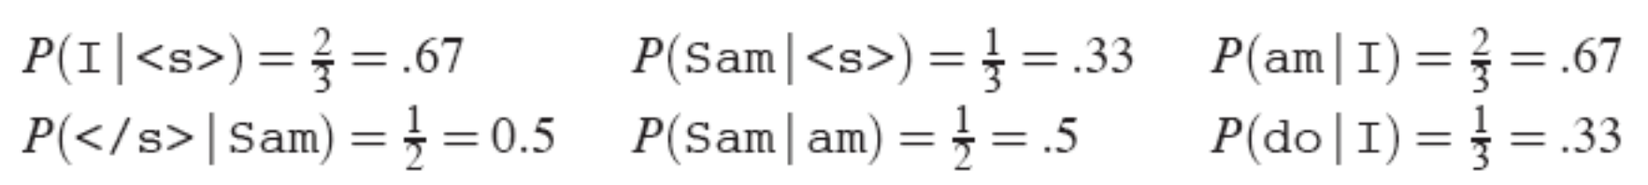
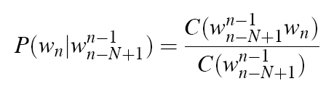
An Example
<s> I am Sam </s>
<s> Sam I am </s>
<s> I do not like green eggs and sam </s>

Slide 26
Maximum Likelihood Estimates
The maximum likelihood estimate of some parameter of a model M from a training set T
Is the estimate that maximizes the likelihood of the training set T given the model M
Suppose the word Chinese occurs 400 times in a corpus of a million words (Brown corpus)
What is the probability that a random word from some other text from the same distribution will be “Chinese”
MLE estimate is 400/1000000 = .004
This may be a bad estimate for some other corpus
But it is the estimate that makes it most likely that “Chinese” will occur 400 times in a million word corpus.

Slide 27

Counting words in corpora
We count word forms not lemmas
Word forms =words as they appear in the corpus
Lemmas= a set of lexical forms having the same stem, the same part-of-speech, and the same word-sense. Example: cat, cats.
We distinguish types – the number of distinct words in a corpus of vocabulary size V, from tokens, the total number N of running words.
Simple (unsmoothed) N-grams
Suppose we want to compute the probability of word w given its history h as P(w|h)
Copyright 2003 by Dan Moldovan

Slide 28
Bigrams and N-Grams
Bigram model - approximates the probability of a word given all the previous words by the conditional probability of the preceding word.
P(W |W ^{n−1}) ≈ P(W |W )
n 1 n n−1
n
P(W₁ ) ≈ ∏P(W_{k} |W_{k −1})
n
k =1
N-gram model - approximates the probability of a word given all the previous words by considering only the conditional probability of the previous N-1 words.
P (W | W ^{n −1} ) ≈ P (W | W ^{n −1} )
n 1 n n − N +1
How do we compute this probability???
Copyright 2003 by Dan Moldovan

Slide 29
Berkeley Restaurant Project Sentences
can you tell me about any good cantonese restaurants close by
mid priced thai food is what i’m looking for
tell me about chez panisse
can you give me a listing of the kinds of food that are available
i’m looking for a good place to eat breakfast
when is caffe venezia open during the day

Slide 30
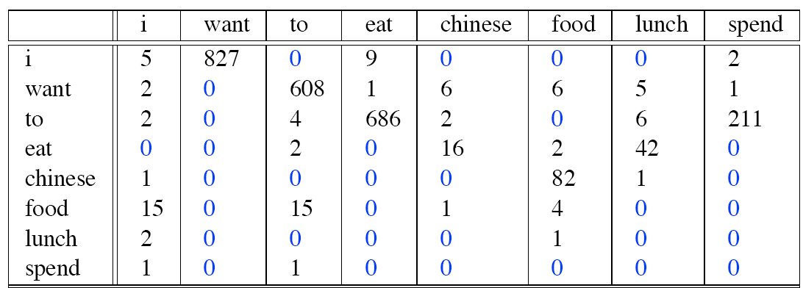
Bigram Counts
Out of 9222 sentences
Eg. “I want” occurred 827 times

Slide 31
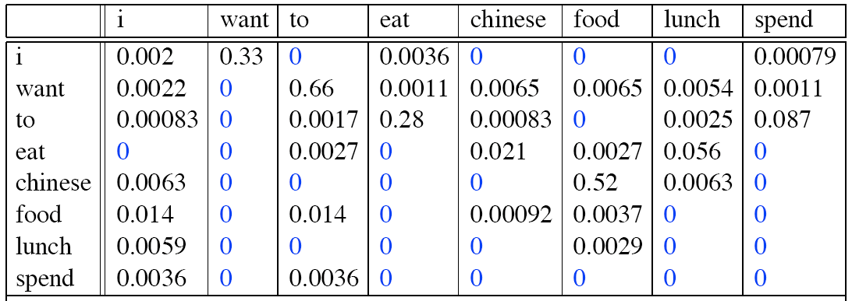
Bigram Probabilities
Divide bigram counts by prefix unigram counts to get probabilities.

Slide 32
Bigram Estimates of Sentence Probabilities
P(<s> I want english food </s>) = P(i|<s>)*
P(want|I)* P(english|want)* P(food|english)*
P(</s>|food)*
=.000031

Slide 33
Kinds of Knowledge
As crude as they are, N-gram probabilities capture a range of interesting facts about language.
P(english|want) = .0011
P(chinese|want) = .0065
P(to|want) = .66
P(eat | to) = .28
P(food | to) = 0
P(want | spend) = 0
P (i | <s>) = .25
World knowledge
Syntax
Discourse

Slide 34
Training and Test Sets
The probabilities of the N-gram come from the corpus it is trained on.
The parameters of any statistical model are trained on some data and then they are tested on a different data.
Training corpus
Testing corpus
How do we create a training corpus and a testing corpus?
Take a corpus – and divide it into a training set and a testing set.
This training-and-testing paradigm can be used to evaluate different N-gram architectures.
Suppose we train two different N-gram models on the training set (e.g. bigram and trigram). We want to see which one performs better on the test set!
Which one better models the test set???
Copyright 2003 by Dan Moldovan

Slide 35
Held-out Sets and Development Sets
To measure how well a statistical model matches a test corpus, we have a measure called perplexity.
It is important not to let the test data (sentences) in the training data (sentences). Why? It the test data is mistakenly part of the training data- we shall assign it an artificially high probability. This is called training on the test data. Training on test data introduces a bias that makes probabilities look too high, and causes huge inaccuracies in perplexity.
Sometimes we need an extra source of data to augment the training data. Such data is called held-out set – because it is hold out from the training data. It is used to set some parameters – e.g. interpolation.
Sometimes we need to have multiple test sets. If we use a test set very often, we implicitly tune its charactersitics.
Solution: We get a second test set. The first test set is called
development set or devset.
Copyright 2003 by Dan Moldovan

Slide 36
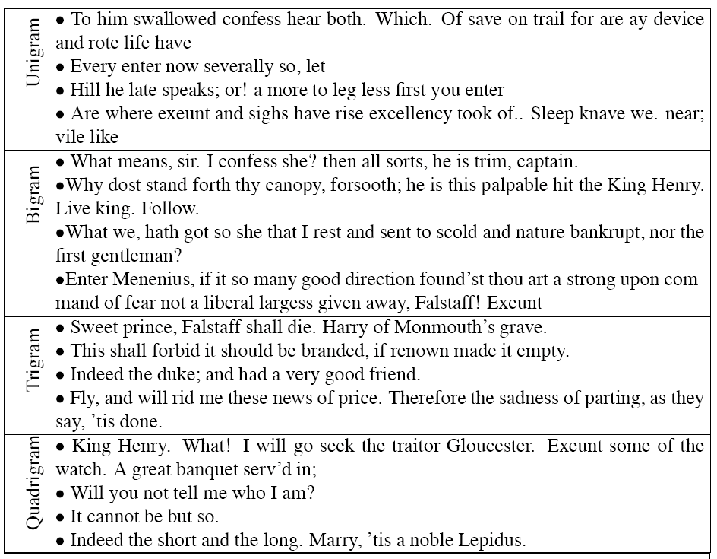
Shakespeare

Slide 37
Shakespeare as a Corpus
N=884,647 tokens, V=29,066
Shakespeare produced 300,000 bigram types out of V²= 844 million possible bigrams...
So, 99.96% of the possible bigrams were never seen (have zero entries in the table)
This is the biggest problem in language modeling; we’ll come back to it.
Quadrigrams are worse: What's coming out looks like Shakespeare because it is Shakespeare

Slide 38
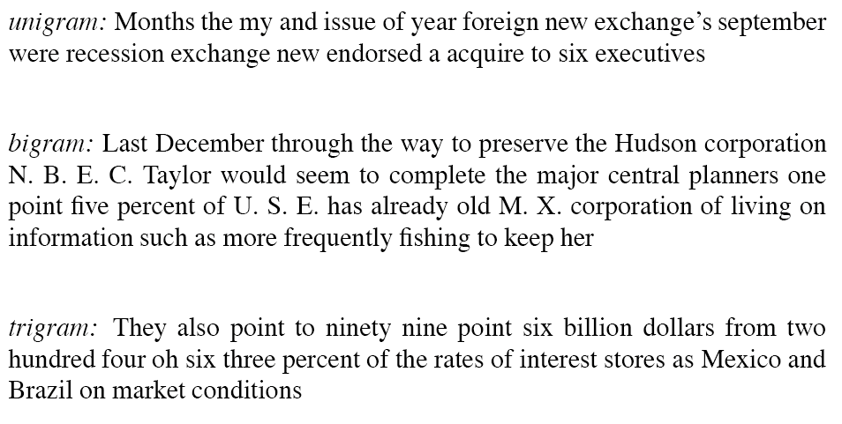
The Wall Street Journal is Not Shakespeare

Slide 39
Evaluating N-Gram Models
Best evaluation for a language model
Put model A into an application
For example, a speech recognizer
Evaluate the performance of the application with model A
Put model B into the application and evaluate
Compare performance of the application with the two models
Extrinsic evaluation

Slide 40
Difficulty of extrinsic (in-vivo) evaluation of N-gram models
Extrinsic evaluation
This is really time-consuming
Can take days to run an experiment
So
As a temporary solution, in order to run experiments
To evaluate N-grams we often use an intrinsic
evaluation, an approximation called perplexity
But perplexity is a poor approximation unless the test data looks just like the training data
So is generally only useful in pilot experiments (generally is not sufficient to publish)
But is helpful to think about.

Slide 41
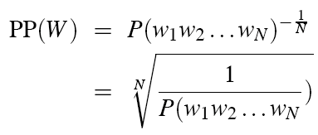
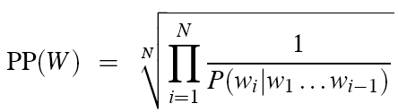
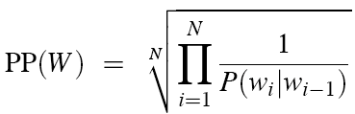
Perplexity
Perplexity is the probability of the test set (assigned by the language model), normalized by the number of words:
Chain rule:
For bigrams:
Minimizing perplexity is the same as maximizing probability
The best language model is one that best predicts an unseen test set

Slide 42
Perplexity
The most common evaluation metric of N-gram language models.
The intuition: given two language models, the better one is the one that has a tighter fit to the test data, or predicts the details of the test data better.
In general, the better language model will assign a higher probability to the test data.
Formally: the perplexity (PP) of a language model on a test set is a function of the probability that the language model assigns to the test set, normalized by the number of words:
PP(W ) = P(w w ...w )^{−1/ N}
1 2 n
Given a test set W = w₁w₂ ...w_{n}
1
= N
P(w₁w₂ ...w_{n} )
Copyright 2003 by Dan Moldovan

Slide 43
Computing the perplexity
We can use the chain rule to expand the probability of W:
PP(W ) = P(w w ...w )^{−1/ N}
1 2 n
1
N
∏
i=1
1
= N
PP(W ) = N
P(w₁w₂ ...w_{n} )
P(w_{i} | w₁w₂ ...w_{i−1} )
In the case of the bigram model:
N
∏
i =1
1
PP(W ) = N
P(w | w )
i
i −1
Copyright 2003 by Dan Moldovan

Slide 44

Lower perplexity means a better model
Training 38 million words, test 1.5 million words, WSJ

Slide 45
Zero Counts
Back to Shakespeare
Recall that Shakespeare produced 300,000 bigram types out of V²= 844 million possible bigrams...
So, 99.96% of the possible bigrams were never seen (have zero entries in the table)
Does that mean that any sentence that contains one of those bigrams should have a probability of 0?

Slide 46
Zero Counts
Some of those zeros are really zeros...
Things that really can’t or shouldn’t happen.
On the other hand, some of them are just rare events.
If the training corpus had been a little bigger they would have had a count (probably a count of 1!).
Zipf’s Law (long tail phenomenon):
A small number of events occur with high frequency
A large number of events occur with low frequency
You can quickly collect statistics on the high frequency events
You might have to wait an arbitrarily long time to get valid statistics on low frequency events
Result:
Our estimates are sparse! We have no counts at all for the vast bulk of things we want to estimate!
Answer:
Estimate the likelihood of unseen (zero count) N-grams!

Slide 47
Smoothing 1
A major problem with MLE: sparse data!
The bigram matrix is sparse.
N-grams tend to underestimate the probability of strings due to the limited size of corpus.
Smoothing is the task of re-evaluating some of the zero-probability and low-probability.
Solution: modify the MLE for computing N-grams and assigning them non-zero values.
Laplace Smoothing
Copyright 2003 by Dan Moldovan

Slide 48
Laplace (Add-One) Smoothing
Does not perform well – it is not used in N-gram modeling
Let’s apply it to the unigram model:
P(w ) = ^{C(wx )}
C – count (number) of words in a type
N – no. of word tokens
x
N
Add-one smoothing adds one to each count. Since there are V words in the vocabulary, and each one got incremented, we also need to adjust the denominator to take into account the extra V observations
_{(w ) =} C(w_{x} ) +1
P
addone
x
N + V
Copyright 2003 by Dan Moldovan

Slide 49
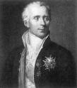
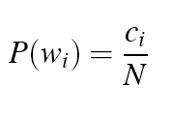

Laplace Smoothing
Also called add-one smoothing
Just add one to all the counts!
Very simple
MLE estimate:
Laplace estimate:

Slide 50
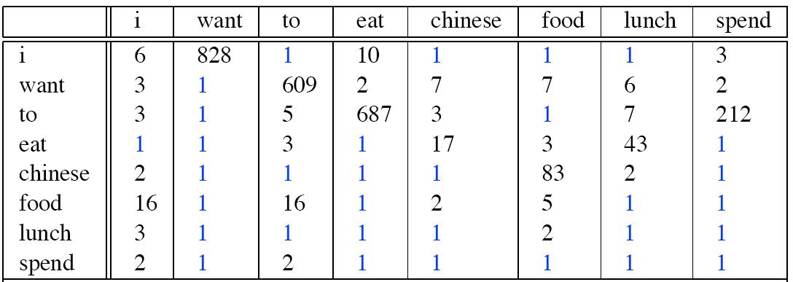
Laplace-Smoothed Bigram Counts

Slide 51

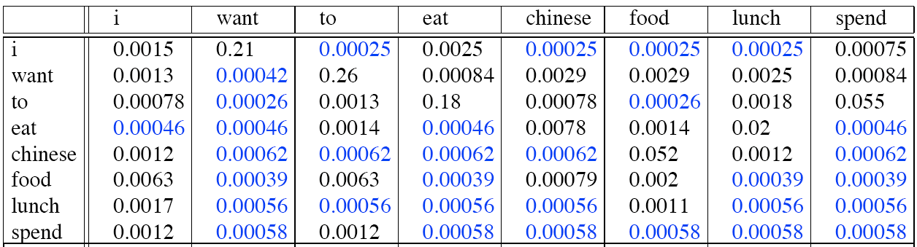
Laplace-Smoothed Bigram Probabilities

